Slide 1



Weekly Meeting
Liri Chen, Shuo Lin, Wenqi Sun, Zhexin Wang, Zixiao Zhang

Slide 2
Weekly plans
Search for resources related to the project
Sync with Ye and Zeya for access to data

Slide 3






Project Pipeline
OCR
Analysis
UI
Raw Data
Data Insights
ChatGPT
End Users
Azure Cloud Services

Slide 4
Resources for OCR
 | Pros | Cons
AWS, Azure OCR | High Accuracy Efficient Can be easily customized | Budget 3rd Party services
Tesseract | Open source Fit well with Python, OpenCV | Limited Accuracy Less customizable
Build from scratch | Fully customizable | Time-consuming Training data

Slide 5
Most challenging/interesting parts
Challenges:
Different table formats within annual reports
- Develop custom scripts and the use of OpenCV for identifying tables contours
Not guarantee 100% accuracy
- Implementing an error-checking mechanism
Interested in:
Web application development

Slide 6
Interesting and Challenging Parts
Multimodal AI
Interest: understands both text and visualization
Challenge: ensure consistency in data interpretation across different modalities
Data Extraction
Interest: extracting data from tables and images in PDF (computer vision, OCR, pattern recognition)
Challenge: uniform extraction (different formats in reports)

Slide 7
Generative Pretrained Models Embedding Challenges
From the feedback of the users, what kinds of insights are they focusing on? How to summarize their focus?
How to make efficient and effective prompts for ChatGPT?
ChatGPT dev needs API key? How to protect this key?
Could we make structural representations of data statistics? (mean, std, cov, corr, skew, CI, etc)

Slide 8
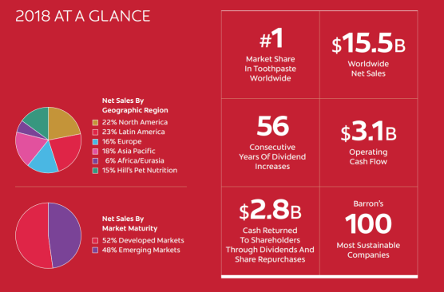
Challenging/Interesting Parts
Challenges：
Diagram Interpretation:
Challenge: Different diagrams (flowcharts, tables, circuit diagrams etc) require individualized processing techniques. Developing models that could interpret and output different diagram formats could be a big challenge
Resource: Mermaid script https://betterprogramming.pub/how-to-create-diagrams-with-chatgpt-19099de795ce
My Interest:
Text detection and extraction using OpenCV and OCR
Reading tables

